Slide 1

Ramesh Pandey
HR Data Analysis
Using MS Excel & PowerBi
Jan 31, 2024

Slide 2
Table of Contents
Introduction
Project Questions & Solutions
Summary

Slide 3
INTRODUCTION
Welcome to HR Data Analytics Project, a comprehensive initiative designed to provide a nuanced perspective on workforce dynamics, performance metrics, and talent management within our organization. Through the strategic utilization of advanced analytics, our primary goal is to equip HR professionals and decision-makers with actionable insights, promoting a sophisticated and informed approach to human resources management. This project serves as a pivotal tool for enhancing organizational efficiency and strategic decision-making in the realm of human capital. Built upon a foundation of data-driven methodologies, our HR Analytics Project stands as a reliable resource for unraveling intricate workforce trends and identifying key performance indicators.

Slide 4
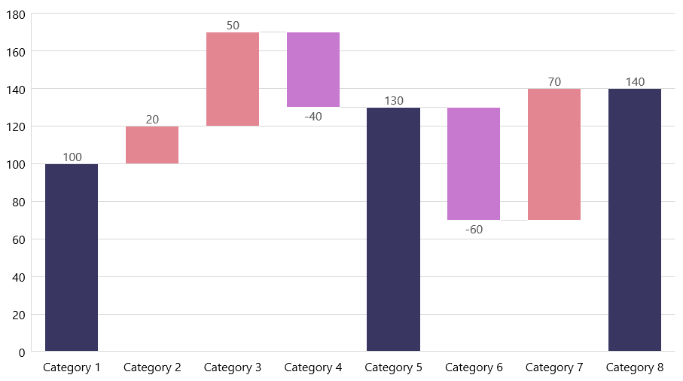
Project Questions & Solutions

Slide 5
Q1. Using Excel, how would you filter the dataset to only show employees aged 30 and above?
To filter a dataset in Excel to only show employees aged 30 and above, our can use the AutoFilter feature. Here are the steps:
Select the Data Range:
Click on any cell within our dataset to select the entire range of data.
Enable AutoFilter:
Go to the "Data" tab in the Excel ribbon, and click on the "Filter" button. This will enable AutoFilter for the selected data range.
Filter the Age Column:
Locate the header of the column that contains the age information. Click on the filter arrow in the header of the age column.

Slide 6
Set Age Filter:
Inside the filter. Go to Number Filter -> Greater Than or Equal To 30.
Apply Filter:
Click the "OK" or "Apply" button in the filter dropdown to apply the filter.
After applying the filter, Excel will display only the rows where employees are aged 30 and above, hiding the rows that do not meet the specified criteria. The row numbers on the left side of the Excel window will indicate if there are hidden rows.

Slide 7
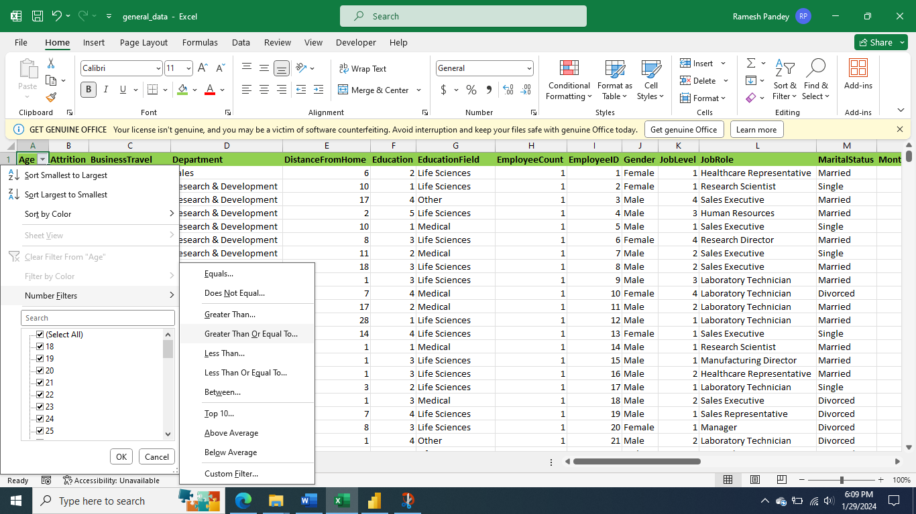

Slide 8
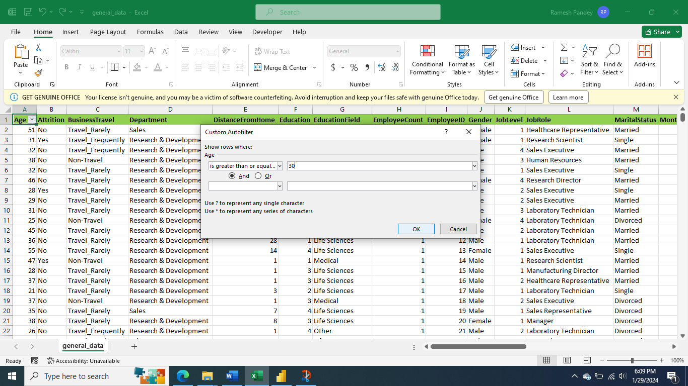

Slide 9
Q2. Create a pivot table to summarize the average Monthly Income by Job Role?
To create a pivot table to summarize the average Monthly Income by Job Role, our have to follow these general steps using Microsoft Excel as an example:
Select data: Highlight the entire dataset, including the column headers.
Insert PivotTable:
Go to the "Insert" tab in the Excel ribbon.
Click on "PivotTable" in the Tables group.
Ensure the "Create PivotTable" dialog box appears.
Confirm that the Table/Range field contains the correct range of our data.

Slide 10
Choose where our want to place our PivotTable (either a new worksheet or an existing one).
Drag fields:
In the PivotTable Field List, drag the "Job Role" field to the Rows area.
Drag the "Monthly Income" field to the Values area. This will automatically use the "Sum" function by default.
Change calculation to average:
Click on the drop-down arrow next to the "Sum of Monthly Income" in the Values area.
Select "Value Field Settings."
Choose "Average" as the summary function and click OK.

Slide 11
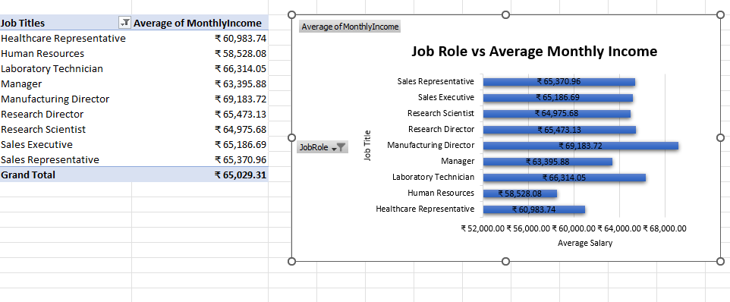
From the above Pivot Table our can conclude that Manufacturing Director job role has the highest monthly average income.

Slide 12
Q3. Apply conditional formatting to highlight employees with Monthly Income above the company's average income?
While solving the last question I got the Company’s Average Monthly Income which is INR65030. To apply conditional formatting to highlight employees with Monthly Income above the company's average income in Microsoft Excel:
Select the Monthly Income Column:
Click on the column header of the Monthly Income column to select the entire column.
Go to the "Home" Tab:
Navigate to the "Home" tab in the Excel ribbon.
Conditional Formatting:
Under the "Home" tab, find the "Conditional Formatting" option in the toolbar.

Slide 13
Highlight Cells Rules:
Hover over "Conditional Formatting" to open the submenu.
Choose "Highlight Cells Rules."
Above Average:
In the "Highlight Cells Rules" submenu, select "Greater Than.”
Adjust Formatting:
A dialog box will appear. Our can set the formatting options here, such as the formatting style and font color.
Click "OK" to apply the formatting.
Now, cells in the Monthly Income column that have values above the company's average income (65030) will be highlighted based on the formatting our chose.

Slide 14
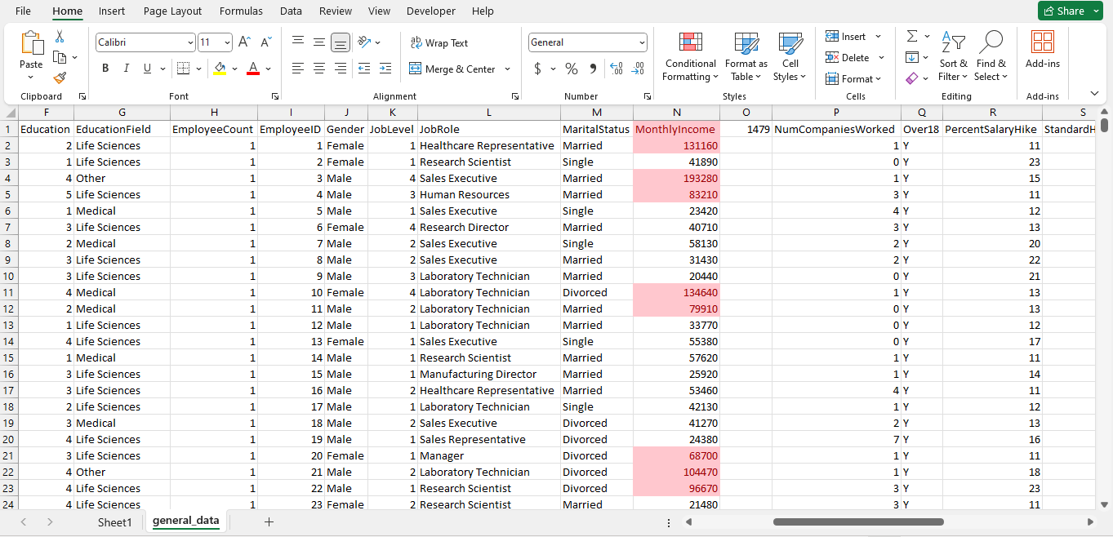
To know the exact value of how many values are above company’s monthly income our can use =COUNTIF(N2:N4411,">65030")
This gives us 1479. So according to this there are a total of 1479 Monthly Income which are greater than Company Average Monthly Income.

Slide 15
Q4. Create a bar chart in Excel to visualize the distribution of employee ages?
To create a bar chart in Excel to visualize the distribution of employee ages using the provided formula to create age bins:
Create Age Bins:
Open Excel:
Open our Excel workbook.
Insert Age Bins:
Adding this formula below to create age bins
=TEXT((FLOOR((A2-18)/4,1)*4+18),"0")&"-"&TEXT((FLOOR((A2-18)/4,1)*4+21),"0")
Create Pivot Table:
Select the entire range including headers (both actual ages in column A and the newly created age bins in column B).
Go to the "Insert" tab and click on "PivotTable."

Slide 16
In the PivotTable Field List, drag the "Age Bin" field to the "Rows" area, and our frequency or count data (let's say, the count of employees in each bin) to the "Values" area.
Create a Bar Chart
Insert Bar Chart:
Highlight the pivot table data (excluding any total rows if generated).
Go to the "Insert" tab and click on "Bar Chart" or "Column Chart."
Customize the Chart:
Right-click on different elements of the chart to customize as needed. Our can add data labels, adjust colors, and title the chart.
Final Touches:
Add any additional details our need, such as axis labels, legends, and a chart title.
Now, our should have a bar chart that visualizes the distribution of employee ages in the specified bins. Each bar represents an age bin, and the height of the bar corresponds to the frequency or count of employees in that bin.

Slide 17
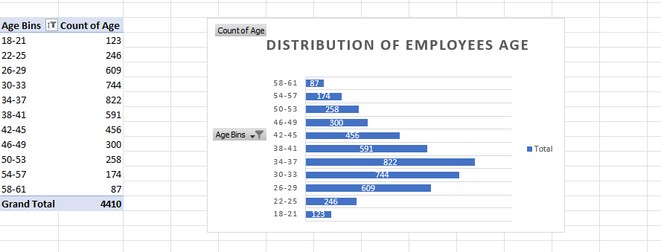
From the above bar chart our can clearly conclude that the age 34-37 contains the most number of employees which is 822.

Slide 18
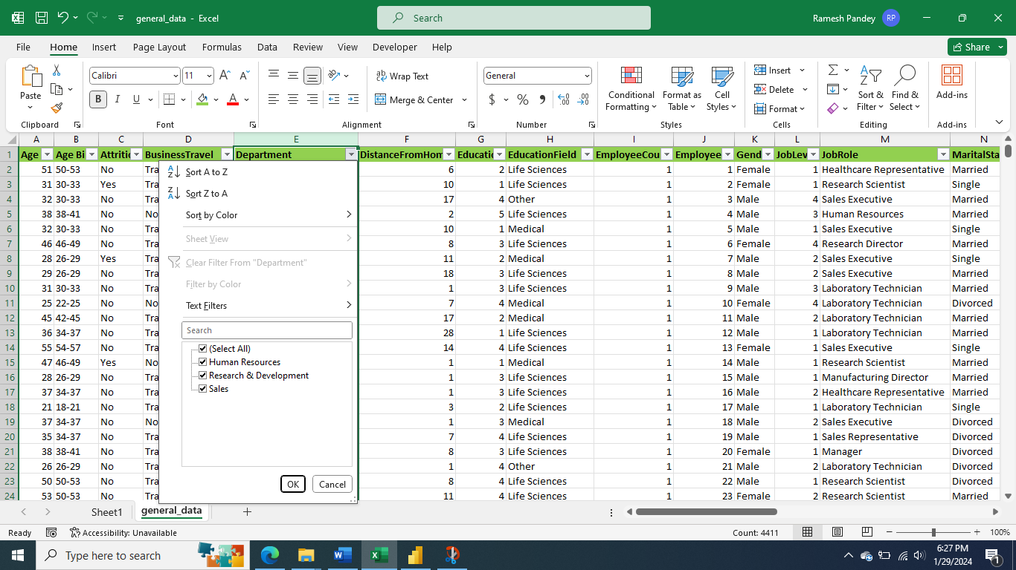
Q5. Identify and clean any missing or inconsistent data in the "Department" column?
After checking the column with filter I got to know that the column named Department doesn’t contains any missing or inconsistent data.

Slide 19
Q6. In Power BI, establish a relationship between the "EmployeeID" in the employee data and the "EmployeeID" in the time tracking data?
A relationship in Power BI is a key step for combining data from different tables. Since we have three tables employee_survey_data, in_time, and out_time, and we want to create a one-to-one relationship between them based on the "EmployeeID" column, follow these steps:
Steps to Establish a Relationship in Power BI:
Open Power BI Desktop:
Launch Power BI Desktop.
Load Tables:
Load the three tables (employee_survey_data, in_time, and out_time) into Power BI project. Our can do this by clicking on "Home" and then selecting "Get Data" to import data from our source.
View Relationships Pane:
Click on the "View" tab in the ribbon.
Ensure the "Relationships" pane is visible. If not, click on "Relationships" in the "View" tab.
Drag and Drop Fields:
In the "Relationships" pane, find the "EmployeeID" field in the employee_survey_data table.

Slide 20
Establish Relationship with in_time Table:
Drag the "EmployeeID" field from the employee_survey_data table and drop it onto the "EmployeeID" field in the in_time table.
Configure the relationship by confirming the fields match and set the relationship type (usually "Single" on both sides).
Establish Relationship with out_time Table:
Similarly, drag the "EmployeeID" field from the employee_survey_data table and drop it onto the "EmployeeID" field in the out_time table.
Configure the relationship as before.
Check Relationships:
In the "Relationships" pane, our should see two lines connecting the employee_survey_data table to both in_time and out_time. The lines represent the relationships.
Load Data:
Ensure that all tables are loaded with data. Click on the "Home" tab and then "Close & Apply" to apply the changes.

Slide 21
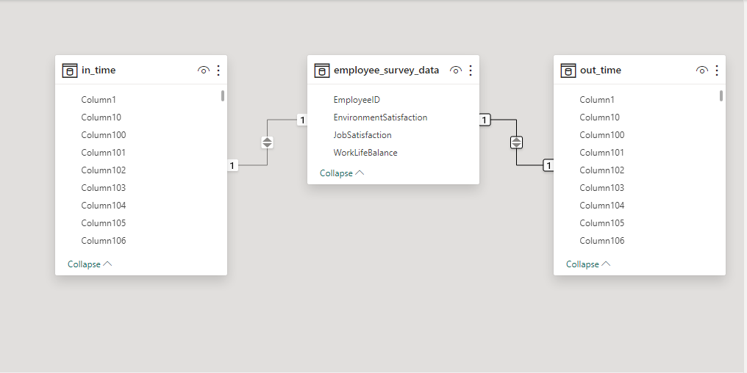
It looks like this.

Slide 22
Q7. Using DAX, create a calculated column that calculates the average years an employee has spent with their current manager?
To create a calculated column that calculates the average year an employee has spent with their current manager in PowerBi our follow these steps.
Open Power BI Desktop:
Open Power BI Desktop on our computer.
Load Data:
Load our data into Power BI Desktop by going to the "Home" tab, selecting "Get Data," and choosing the appropriate source for our general_data table.
Data View:
After loading the data, go to the "Data" view by clicking on the "Data" icon in the left sidebar.
Select Table:
In the Fields pane on the right, locate and select the general_data table.

Slide 23
Create Calculated Column:
In the Fields pane, right-click on the general_data table.
Choose "New Column."
In the formula bar at the top, enter the following DAX formula:
AverageYearsWithCurrentManager = AVERAGE(general_data[Years With Current Manager])
Press Enter to create the calculated column.
Result:
Our will now see a new column named AverageYearsWithCurrentManager in the general_data table. This column contains the average years with the current manager for each row based on the values in the Years With Current Manager column.

Slide 24
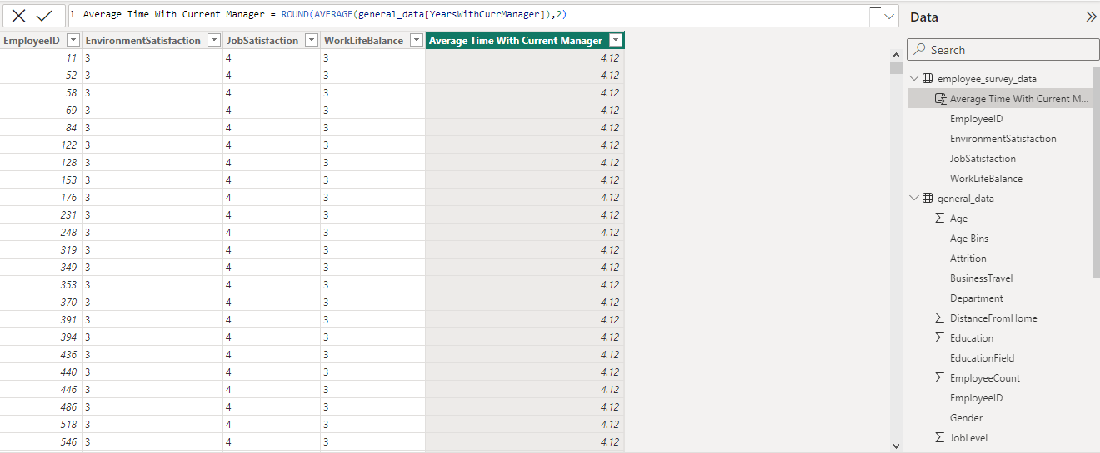
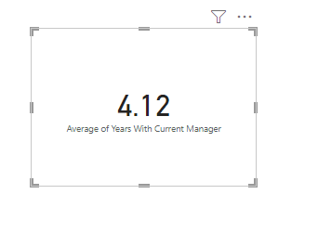

Slide 25
Q8. Using Excel, create a pivot table that displays the count of employees in each Marital Status category, segmented by Department?
To create a pivot table in Excel that displays the count of employees in each Marital Status category, segmented by Department:
Open Excel:
Open our Excel workbook where the employee data is located.
Select Data:
Ensure that our employee data is organized in a table or range. Click and drag to select the range of data that includes columns such as EmployeeID, Marital Status, Department, and other relevant columns.
Insert Pivot Table:
Go to the "Insert" tab in the Excel ribbon.
Click on the "PivotTable" button. This will open the "Create PivotTable" dialog box.
Select Data Range:

Slide 26
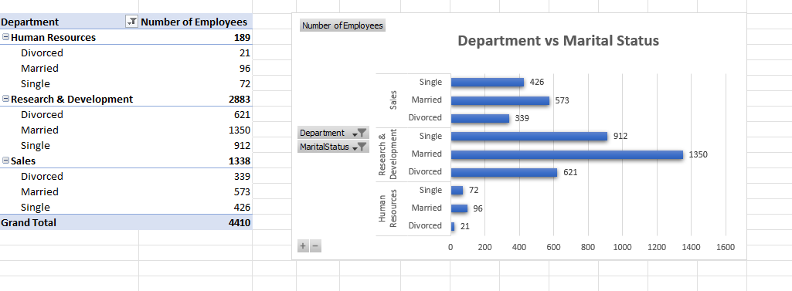
Ensure that the "Table/Range" field in the "Create PivotTable" dialog box is automatically populated with the correct range of our employee data.
Choose where our want to place the PivotTable (e.g., New Worksheet).
5. Design the PivotTable:
In the PivotTable Field List, drag the Department field to the "Rows" area.
Drag the Marital Status field to the "Columns" area.
Drag the EmployeeID field to the "Values" area. By default, it should show "Count of EmployeeID."

Slide 27


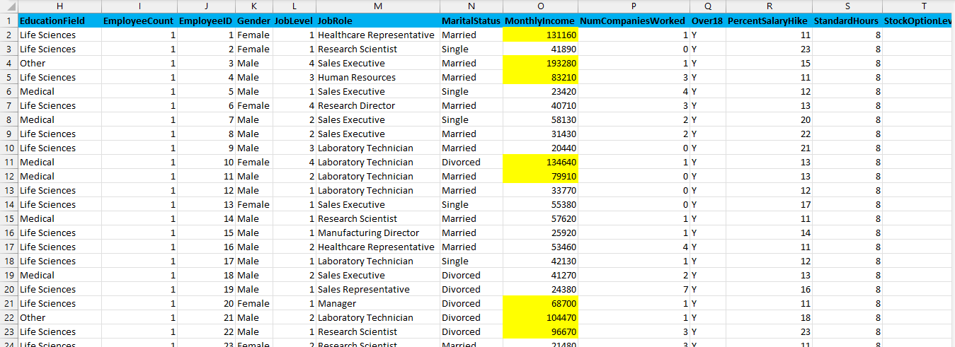
Q9. Apply conditional formatting to highlight employees with both above-average Monthly Income and above-average Job Satisfaction?

Slide 28
Q10. In Power BI, create a line chart that visualizes the trend of Employee Attrition over the years?
To create a line chart that visualizes the trend of Employee Attrition over the year in PowerBi our need to follow these steps.
Load Data:
Open Power BI Desktop.
Load general_data excel file into Power
Create a Line Chart:
In the "Visualizations" pane on the right, select the line chart icon to create a new line chart visualization.
Assign Fields:
Drag the "Years At Company" column to the "X Axis" area.
Drag the " Attrition" column to the "Y Axis" area.
Adjust Axis Range (if necessary):
Ensure the axis range covers the desired time span. Power BI should automatically recognize the time-based field and set it appropriately.

Slide 29
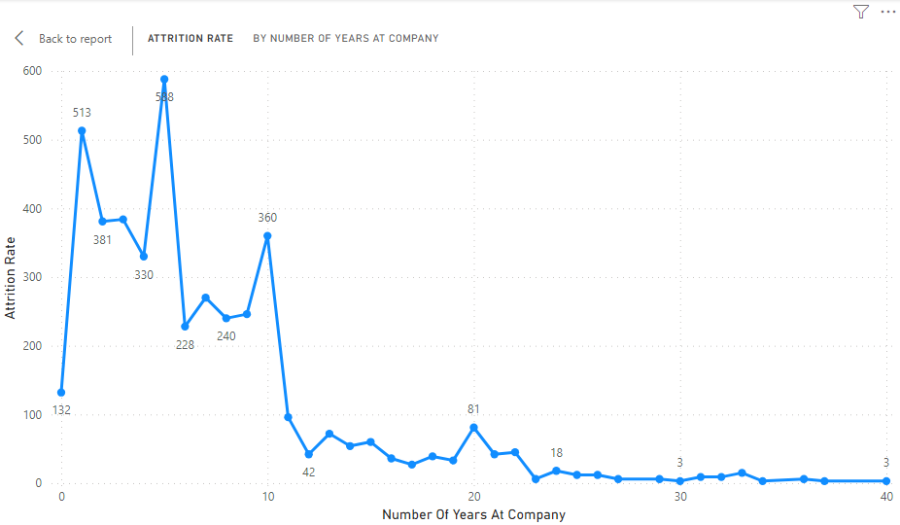
5. Review and Save:
Review the chart to ensure it accurately represents the trend of Employee Attrition over time.
Save our Power BI report.

Slide 30
Q11. Describe how you would create a star schema for this dataset, explaining the benefits of doing so?
Creating a star schema involves designing a database structure that separates data into fact tables and dimension tables.
Fact Table: - general_data
Dimension Table: - employee_survey_data, in_time, out_time, manager_survey_data.
Benefits of Star Schema:
Simplicity: The star schema is simpler and easier to understand than other schema types, making it user-friendly for reporting and analysis.
Query Performance: Queries that involve aggregations and filtering are generally more efficient in a star schema. The structure allows for faster joins and simplified queries.
Scalability: It is easier to add new dimensions or facts to a star schema without disrupting the existing structure, making it scalable as business requirements evolve.
Enhanced Maintenance: Since dimensions are separate from the fact table, any changes to dimension attributes do not affect the fact table. This separation simplifies maintenance and updates.

Slide 31
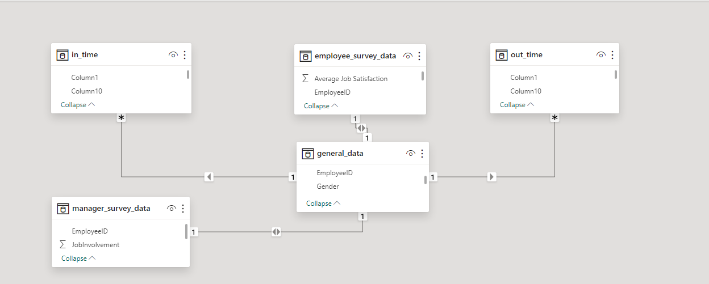
Relationship: - in_time and general_data have Many-to-One relationship because for a single EmployeeID there are multiple In Time.
Similarly, out_time and general_data have Many-to-One relationship because for a single EmployeeID there are multiple Out Time.
Now employee_survey_data and general_data have One-to-One relationship because for a single EmployeeID there is only one Employee Survey. Similarly, for manager_survey_data and general_data have One-to-One relationship because for a single EmployeeID there is only one Manager Survey.

Slide 32
Q12. Using DAX, calculate the rolling 3-month average of Monthly Income for each employee?
RollingAvgMonthlyIncome = CALCULATE(AVERAGE(general_data[MonthlyIncome]),FILTER(ALL(general_data),general_data[EmployeeID] = EARLIER(general_data[EmployeeID]) && general_data[DateColumn] <= EARLIER(general_data[DateColumn]) && general_data[DateColumn] > DATEADD(EARLIER(general_data[DateColumn]) -3,MONTH)))

Slide 33
Q13 . Create a hierarchy in Power BI that allows users to drill down from Department to Job Role to further narrow their analysis?
Creating a hierarchy in Power BI allows users to drill down from higher-level categories to more detailed ones. In our case, our want to create a hierarchy that goes from "Department" to "Job Role." Here are the steps to achieve this. Assuming our have a table in Power BI that contains columns for "Department" and "Job Role," follow these steps:
Open Power BI Desktop: Open Power BI Desktop and load the data into it.
Load our Data: Make sure our data is loaded into Power BI. Our should have a table containing columns for "Department" and "Job Role.“
Data Model View: Click on the "Model" icon on the left side of the Power BI Desktop interface. This will take our to the data model view.
Select Our Table: In the data model view, find and select the table that contains our "Department" and "Job Role" columns.
Create Hierarchy: Right-click on the "Department" column, and from the context menu, choose "New Hierarchy." Name the hierarchy appropriately, like "Department Hierarchy."

Slide 34
Add Job Role to Hierarchy: Drag the "Job Role" column and drop it onto the "Department Hierarchy" that our just created. This will add the "Job Role" as a sub-level under the "Department.“
Arrange Hierarchy: Our can arrange the hierarchy by dragging and dropping the columns within the hierarchy. Ensure that "Department" is above "Job Role" in the hierarchy.
Test the Hierarchy: Go back to the "Data" view, and our should see the new hierarchy in our field list. Drag and drop this hierarchy onto our report canvas. Our can now drill down from "Department" to "Job Role" by clicking on the expand icons next to the hierarchy levels.
Format and Customize (Optional): Our can customize the hierarchy by adjusting the formatting, labels, and other settings in the visualization pane.
Save and Publish: Save our Power BI report, and if our are using Power BI Service, publish it to the Power BI service to share it with others. By following these steps, our should be able to create a hierarchy in Power BI that allows users to drill down from "Department" to "Job Role" for more detailed analysis.

Slide 35
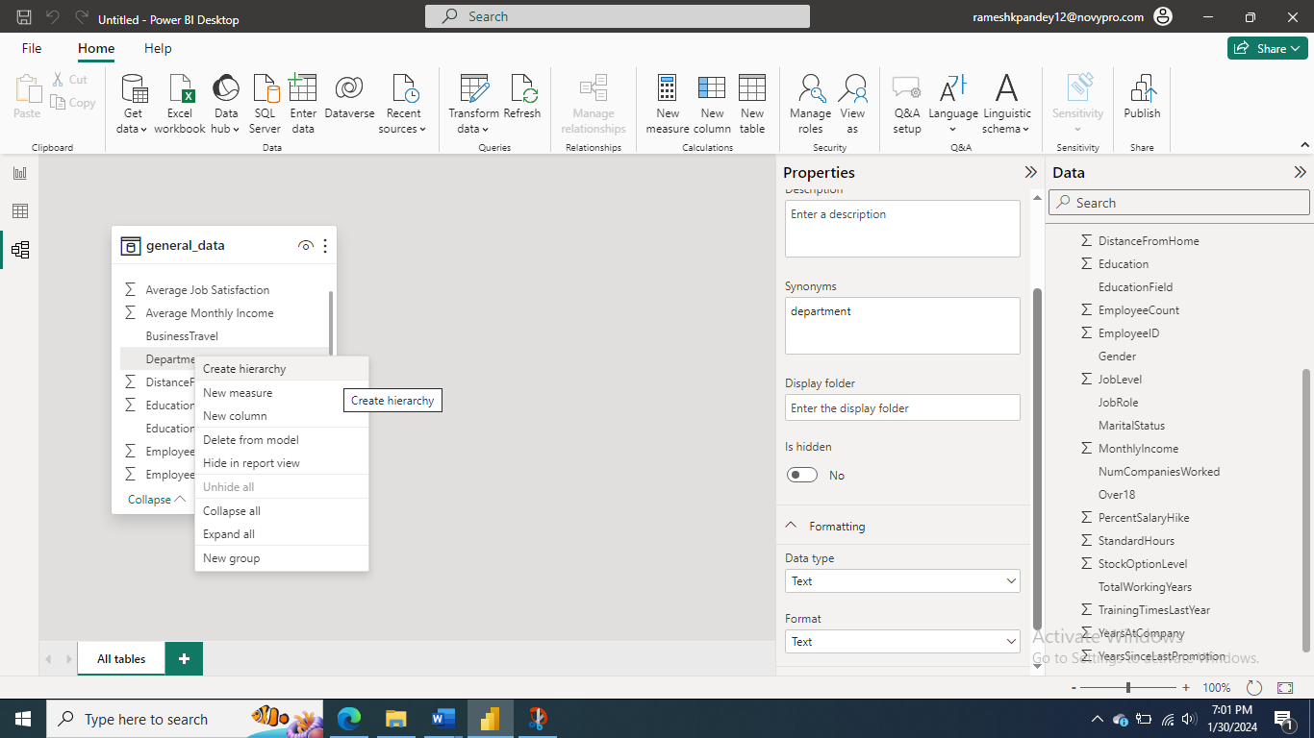
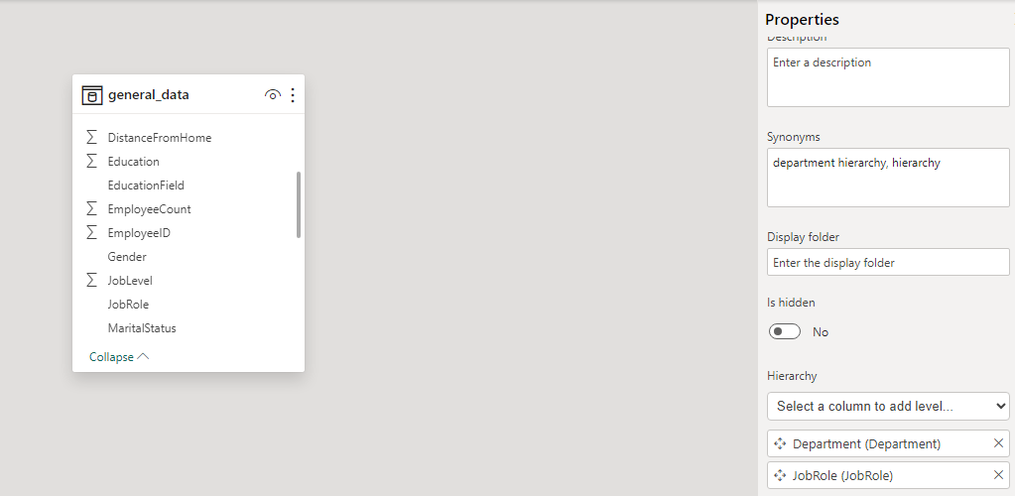
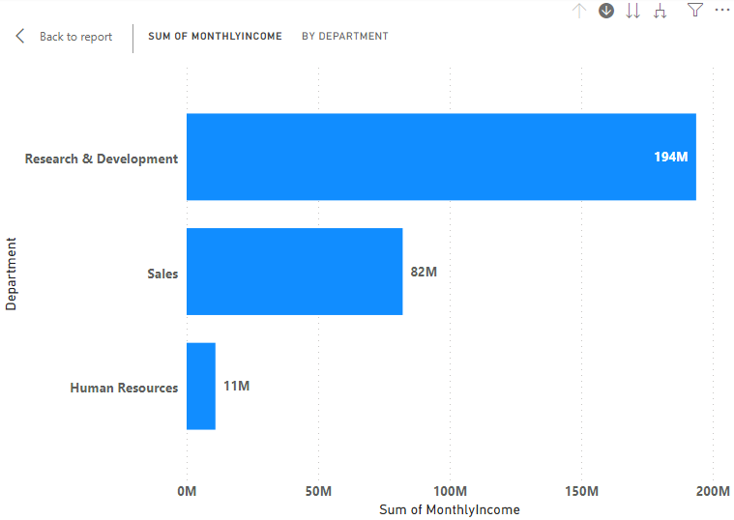
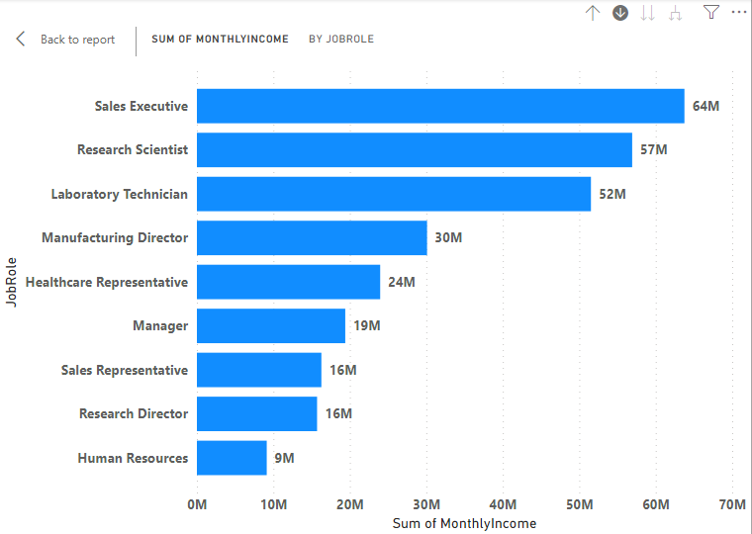

Slide 36
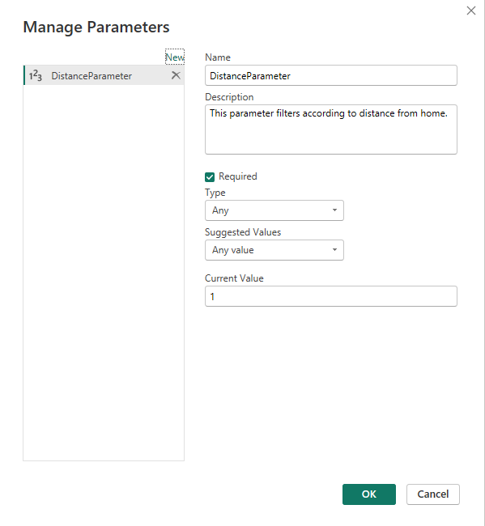
Q14 . How can you set up parameterized queries in Power BI to allow users to filter data based 2 of 2 on the Distance from Home column?
In Power BI, parameterized queries allow us to create dynamic queries where the query logic can be adjusted based on parameters. This is particularly useful when you want to reuse a single query structure with different filter conditions, making your reports more flexible and dynamic. This allows you to create more flexible and reusable reports by changing the parameter values without modifying the underlying query structure. Parameterized queries are commonly used in scenarios where we need to filter data based on user input, date ranges, or other dynamic criteria.

Slide 37
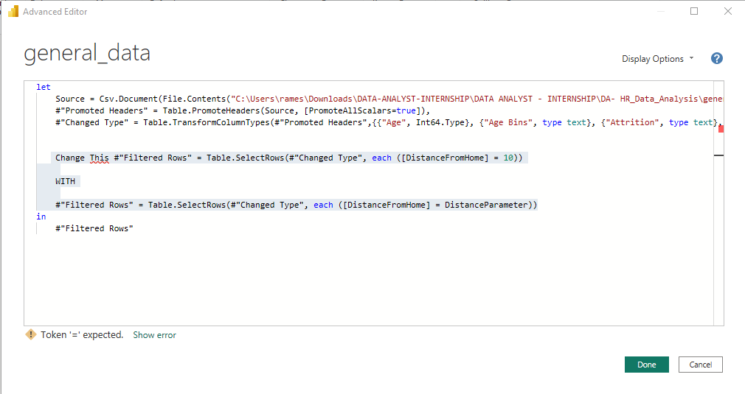
If I change the current value of the parameter shown below then this will change the entire visuals from the report tab like when I made the current value 1 it started showing me 624 results.

Slide 38
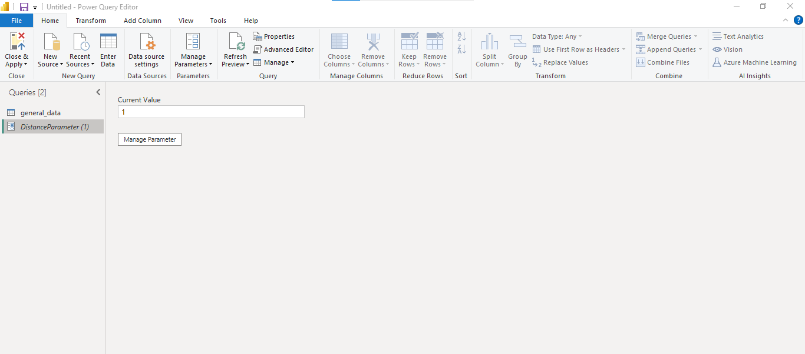

Slide 39
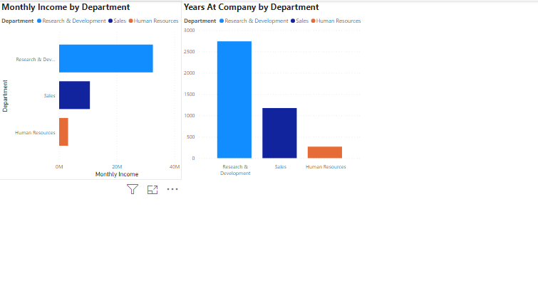
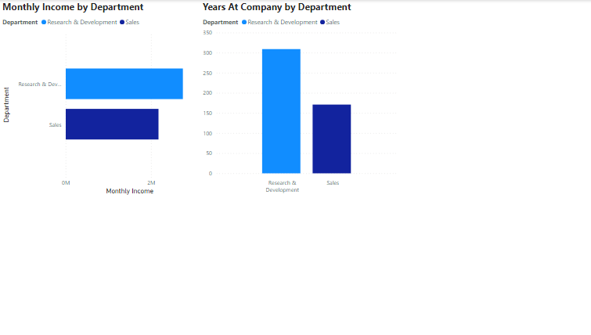
This is when I made current value of Parameter 1. It affected 624 rows and made these changes to views
This is when I made current value of Parameter 15. It affected 78 rows and made these changes to the views.

Slide 40
Q15 . In Excel, calculate the total Monthly Income for each Department, considering only the employees with a Job Level greater than or equal to 3?
To calculate the total Monthly Income for each Department, considering only employees with a Job Level greater than or equal to 3 in Excel:
Load Your Data: Open Excel and load your data into a new worksheet.
Create a PivotTable:
Select your data range.
Go to the "Insert" tab in the Excel ribbon.
Click on "PivotTable" and select the location where we want the PivotTable to be placed (either a new worksheet or an existing one).
Design the PivotTable:
Drag the "Department" field to the Rows area.
Drag the "Monthly Income" field to the Values area. It should automatically sum the values.
Filter by Job Level:
Locate the "Job Level" field in the PivotTable Field List.

Slide 41
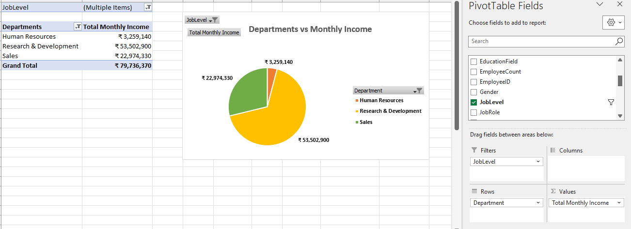
Drag the "Job Level" field to the Filters area.
Use the filter dropdown to select only Job Level 3 and above.
5. Verify Results:
Check the values in the "Monthly Income" column to ensure they represent the total Monthly Income for each Department, considering only employees with a Job Level greater than or equal to 3.

Slide 42
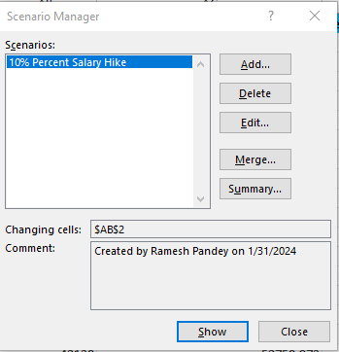
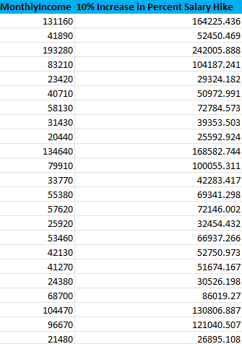
Q16 . Explain how to perform a What-If analysis in Excel to understand the impact of a 10% increase in Percent Salary Hike on Monthly Income?

Slide 43
Q17 . Verify if the data adheres to a predefined schema. What actions would you take if you find inconsistencies?
Verifying if data adheres to a predefined schema is a crucial step in ensuring data quality and integrity. Here are some actions you can take if inconsistencies are found:
Document the Inconsistencies:
Record the specific details of the inconsistencies, including the data points, types of errors, and any patterns observed.
Document where the inconsistencies were found in the dataset.
Notify Stakeholders:
Inform relevant stakeholders, such as data owners, data engineers, or data analysts, about the identified inconsistencies.
Share the documented information to facilitate communication and understanding.
Investigate the Root Cause:
Conduct a thorough investigation to determine the root cause of the inconsistencies.
Analyze the data sources, transformation processes, and any recent changes that might have contributed to the issues.

Slide 44
4. Correct Data at the Source:
If possible, correct the data at the source to eliminate the inconsistencies.
Work with data providers or system administrators to rectify any issues in the upstream systems.
5. Data Cleaning and Transformation:
Develop and implement data cleaning and transformation processes to rectify inconsistencies in the dataset.
Utilize data cleansing techniques, such as removing duplicates, filling missing values, or transforming data formats.
6. Update Schema Definition:
If the inconsistencies are due to changes in data structure, update the predefined schema to reflect the new data requirements.
Collaborate with relevant teams to ensure that schema changes are communicated and implemented consistently.
7. Implement Validation Checks:
Enhance validation checks to prevent similar inconsistencies in the future.
Introduce additional validation rules, constraints, or automated tests to ensure that incoming data adheres to the predefined schema.

Slide 45
8. Data Quality Monitoring:
Set up continuous data quality monitoring processes to identify and address inconsistencies proactively.
Establish alerts or notifications for deviations from the expected data quality standards.
9. Data Governance Practices:
Review and, if necessary, enhance data governance practices to prevent inconsistent data in the future.
Clearly define roles, responsibilities, and processes related to data quality within the organization.
10. Documentation and Communication:
Update documentation to reflect any changes made to the schema or data cleaning processes.
Communicate the resolution of inconsistencies to stakeholders and provide guidance on any necessary adjustments to their workflows.

Slide 46
SUMMARY
An HR Data Analytics project involves the use of data analysis and interpretation to gain valuable insights into various human resources aspects within an organization. This can include analyzing employee performance, turnover rates, recruitment effectiveness, training impact, and other HR-related metrics. The goal is to make data-driven decisions that enhance HR processes, improve employee satisfaction, and contribute to overall organizational success. The project may leverage tools and techniques such as statistical analysis, excel, and visualization to extract meaningful patterns and trends from data. Ultimately, HR Data Analytics aims to optimize workforce management and foster a more efficient & productive work environment.

Slide 47
THANK YOU
Ramesh Kumar Pandey

